Slide 1
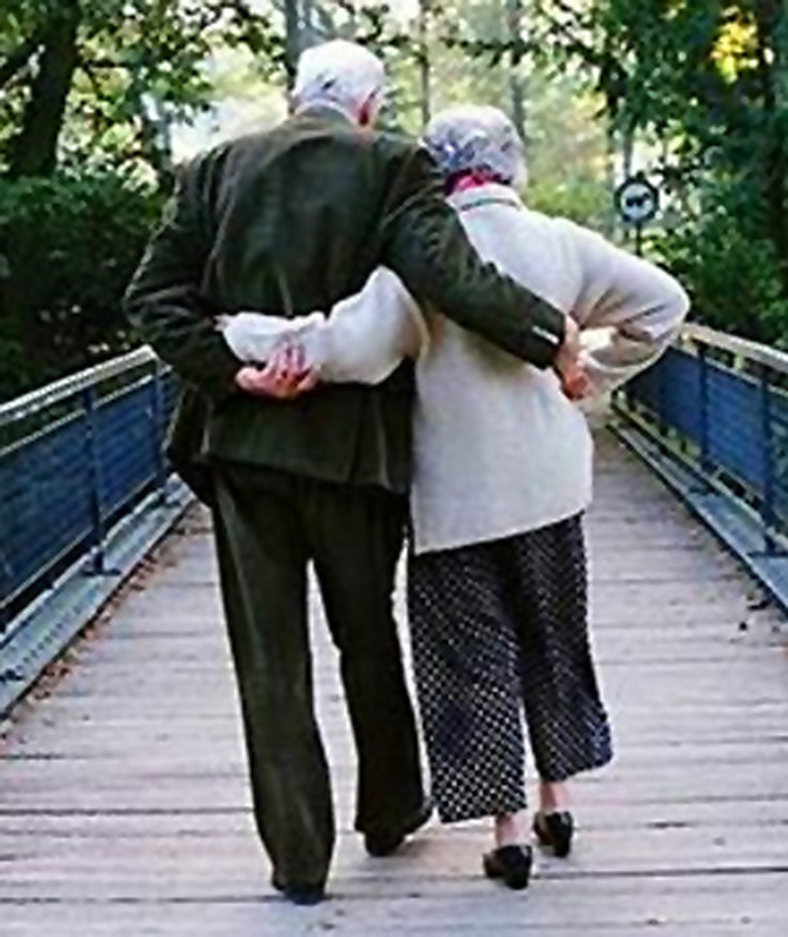
Married: Growing & Serving Together
A Study of Marriage, Spring 2023

Slide 2
How We Communicate In Our Marriages
How to hear and be heard in both calm and crisis

Slide 3
How We Communicate In Our Marriages
The importance of effective communications in marriage
Hindrances to achieving effective communications and how we can overcome them

Slide 4
Epic Communication Failures
Congratulations! You’re NOT accepted.
In 2009 the University of California at San Diego sent an email congratulating students who were accepted to the university. The problem? The university fired off the email to ALL 47,000 applicants, including the tens of thousands who had already received rejection notices.

Slide 5
The Incredible Power of Words
“Then God said…”
Let there be light
Let there be firmament
Let the …waters be gathered together
Let the earth bring forth grass
Let there be lights in the heavens
Let the earth bring forth living creatures
Let us make man in Our image

Slide 6
The Incredible Power of Words
“I tell you, on the day of judgment people will give account for every careless word they speak, for by your words you will be justified, and by your words you will be condemned.” Matthew 12:36-37

Slide 7
The Incredible Power of Words
“Heaven and earth will pass away, but my words will not pass away.” Matthew 24:35

Slide 8
The Incredible Power of Words
Death and life are in the power of the tongue, and those who love it will eat its fruits. Proverbs 18:21

Slide 9
The Incredible Power of Words
Know this, my beloved brothers: let every person be quick to hear, slow to speak, slow to anger; for the anger of man does not produce the righteousness of God. James 1:19-20

Slide 10
Married: Growing & Serving Together
A Study of Marriage, Spring 2023

Slide 11
If ever two were one, then surely we. If ever man were loved by wife, then thee. – Ann Bradstreet

Slide 12
By Way of Review
The importance of effective communications in marriage
Establishes and builds understanding
Critical in helping resolve conflict
Builds trust
Enhances emotional intimacy

Slide 13
The Importance of Effective Communications in Marriage
Strengthens decision-making
Contributes to long-term happiness
Strengthens your spiritual life

Slide 14
Hindrances Towards Effective Communications in Marriage
What they are and how we can overcome

Slide 16
Things that hinder our efforts to Communicate
Poor listening skills
Hearing and Listening are two different things. It’s always been that way.
“He who has ears, let him hear.” Matthew 13:9

Slide 17
Things that hinder our efforts to Communicate
Emotional Barriers
Defensiveness
Anger
Resentment

Slide 18
Things that hinder our efforts to Communicate
Busy schedules and distractions
Work
Technology
Social media

Slide 19
Things that hinder our efforts to Communicate
Unresolved Conflict
Lingering negative emotions
Difficulty addressing current issues constructively

Slide 20
Things that hinder our efforts to Communicate
Poor communication habits
Interrupting
Criticizing
Avoiding difficult conversations

Slide 21
Things that help in our efforts to Communicate
…and he died for all, that those who live might no longer live for themselves but for him who for their sake died and was raised. II Corinthians 5:15

Slide 22
Things that help in our efforts to Communicate
Final Thoughts
Sometimes one of the main reasons we differ is over how significant our differences are
Should annoyances rise to the level of conflict in our marriages?

Slide 23
Things that help in our efforts to Communicate
“Good sense makes one slow to anger, and it is his glory to overlook an offense.” Pr. 19:11

